Slide 1
Data Structure Program
WAP to insert the element in the array.
WAP to delete in a specific position in the array.
WAP to perform stack operation.
WAP to perform queue operation.
WAP to implement stack using linked list.
WAP to implement linked list.
WAP to implement quick sort.
WAP to demonstrate merge sort.
WAP to demonstrate insertion sort.
WAP to determine Binary search.

Slide 2
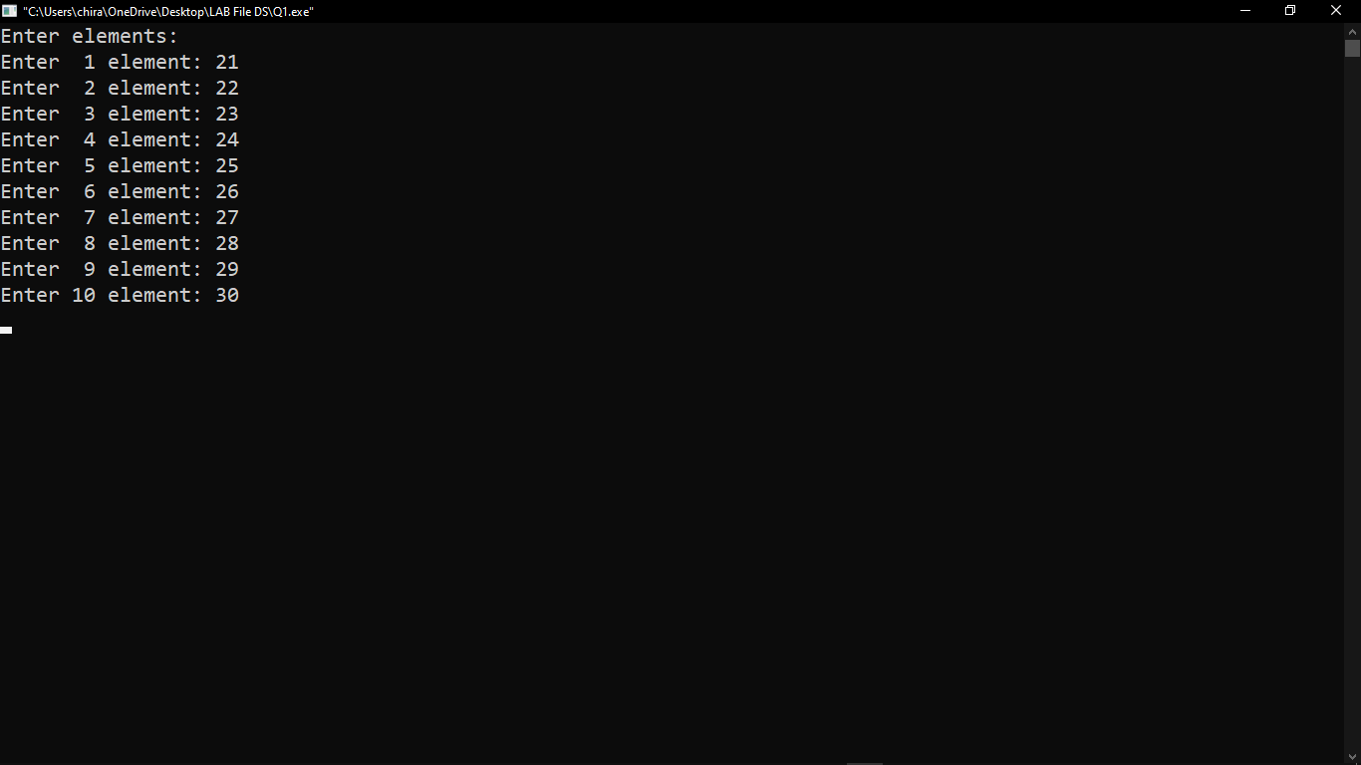

Slide 3
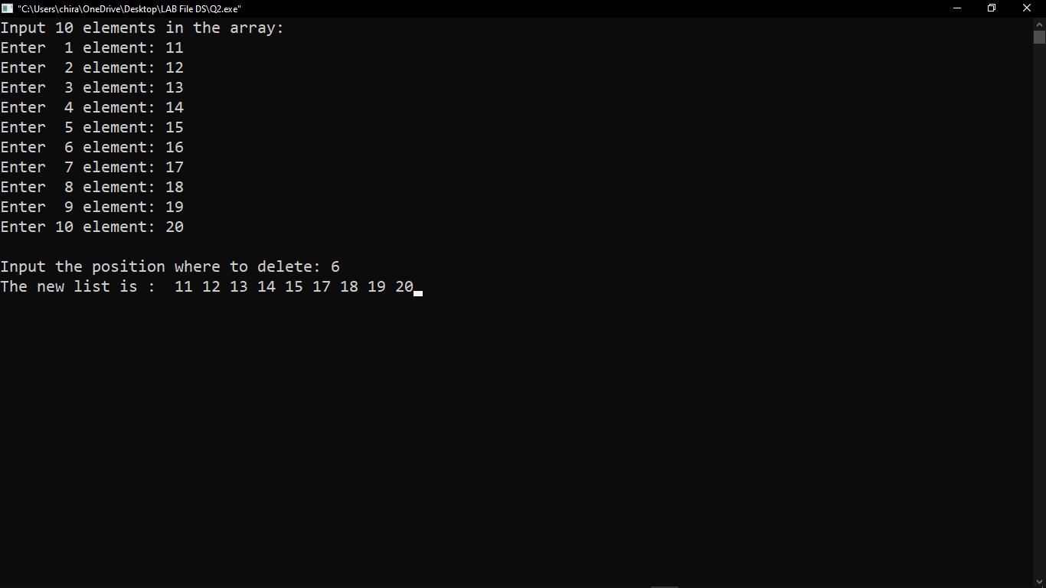

Slide 4
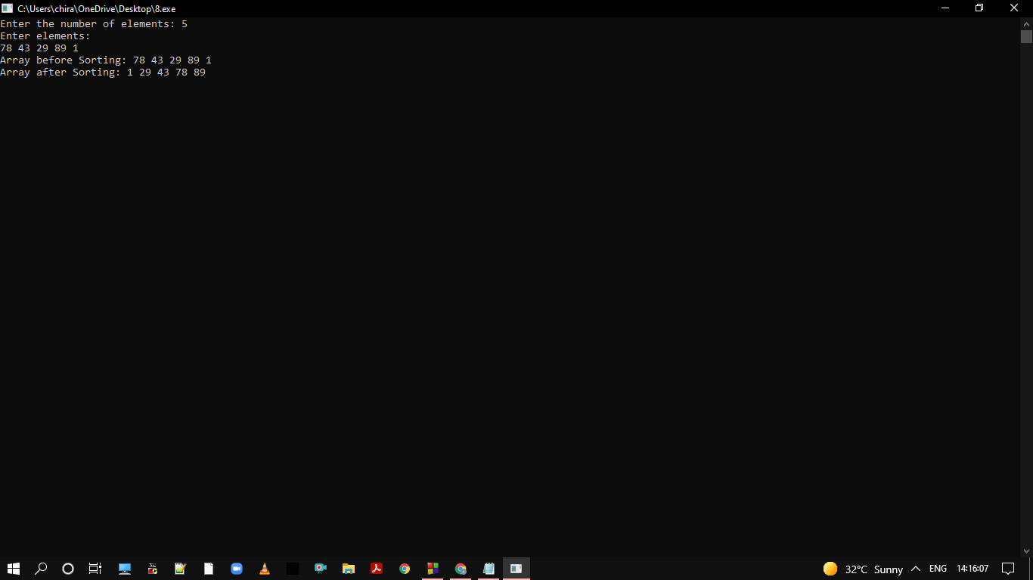

Slide 5
